Slide 1
JavaScript Part 4

Slide 2

Hello world!
I AM NIKKI NAIDOO
You can contact me on
Nikki.naidoo@entelect.co.za

Slide 3
JavaScript Part 4
Style Guide
This keyword
Scope
Forms
Debugging
Errors
Classes
Reserved Words
Best Practices

Slide 4
Style Guide
JavaScript Coding Conventions
Notes:
Coding conventions are style guidelines for programming. They typically cover:
Naming and declaration rules for variables and functions.
Rules for the use of white space, indentation, and comments.
Programming practices and principles
Coding conventions secure quality:
Improves code readability
Make code maintenance easier
Coding conventions can be documented rules for teams to follow, or just be your individual coding practice.

Slide 5
Variable Names
Why is variable naming important?
Because superlongvariablenamesarereallyhardtoreadifnotcasedproperly

Slide 6

Variable Names
camelCase for identifier names (variables and functions).
All names start with a letter.
firstName = ‘Nikki’;
lastName = ‘Naidoo’;
function getFullName(firstName, lastName) {
return firstName + ‘ ’ + lastName;
}
Notes:
Camel case is named after the "hump" of its protruding capital letter, similar to the hump of camels. It starts with a lowercase letter, and all words following to start with a capital letter with no spaces inbetween.
It becomes really easy to read, especially when variable names start to get long.
Do not start names with a $ sign. It will put you in conflict with many JavaScript library names.
Hyphens are not allowed in JavaScript names as they can be mistaken as subtraction attempts.

Slide 7


Spaces for Readability
Always put spaces:
around operators ( = + - * / )
after commas
let sum = 212 + 8563;
const nameArray = [‘Almarie’, ‘Mimi’, ‘Bob’];
VS
let sum=212+8563;
const nameArray=[‘Almarie’,‘Mimi’,‘Bob’];
Notes:
In regular English, we use spaces after each word and punctuation to aid in readability. It’s exactly the same in JavaScript and other programming languages.
Look at the code at the top compared to the code below it.

Slide 8
Code Indentation
Indentation refers to the spaces at the beginning of a code line. It helps you tell which logical block of code it belongs to.
Notes:
Indentation refers to the spaces at the beginning of a code line. Where in most languages like JavaScript, the indentation in code is for readability only, the indentation in Python is very important. Python uses indentation to indicate a block of code.

Slide 9
Code Indentation
class MealPlan {
function getMeal(day) {
let meal = ‘’;
if(day == ‘Sunday’)
meal = ‘Sunday Roast’;
else if(day == ‘Monday’)
meal = ‘Veggies’;
else
meal = ‘meatloaf’;
}
}

Slide 10
Code Indentation
class MealPlan {
→ function getMeal(day) {
→ → let meal = ‘’;
→ → if(day == ‘Sunday’)
→ → → meal = ‘Sunday Roast’;
→ → else if(day == ‘Monday’)
→ → → meal = ‘Veggies’;
→ → else
→ → → meal = ‘meatloaf’;
→ }
}
Notes:
All code that starts after the red indentation is in the class MealPlan.
All code that starts after the green indentation is within the function getMeal.
All code that starts after the blue indentation are logic that’s within the if-else blocks.

Slide 11
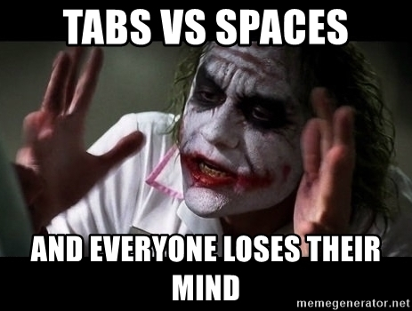
Code Indentation
Notes:
Ahh the age old debate – tabs vs spaces!

Slide 12
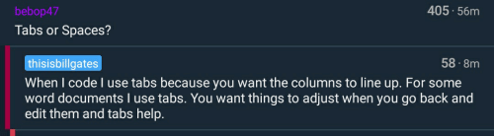
Code Indentation
Two pretty cool people have tabs as their personal preference:
Cool kids use tabs.
thisIsNikNaks
Notes:
What’s your preference?

Slide 13
Code Indentation
If you choose to use spaces, use TWO spaces for each indentation.
If you choose to use tabs, use ONE tab for each indentation.
Since coding standards need to remain consistent, you or your team needs to decide on either tabs or spaces and commit to it!

Slide 14
Statement Rules – Simple Statements
Always end a simple statement with a semicolon.
const treats = [“Bar-One", “Chomp", “KitKat"];
const person = {
firstName: "Johnny",
lastName: "Doey",
age: 25
};
Notes:
What is the difference between simple statement and compound statement?
- A simple statement is one that does not contain another statement as a component.
- A compound statement contains at least one simple statement as a component, along with a logical operator, or connectives.

Slide 15
Statement Rules – Complex/Compound Statements
Put the opening bracket at the end of the first line.
Use one space before the opening bracket.
Put the closing bracket on a new line, without leading spaces.
Do not end a complex statement with a semicolon.
// functions
function toCelsius(fahrenheit) {
return (5 / 9) * (fahrenheit - 32);
}
Notes:
What is the difference between simple statement and compound statement?
- A simple statement is one that does not contain another statement as a component.
- A compound statement contains at least one simple statement as a component, along with a logical operator, or connectives.

Slide 16
Statement Rules – Complex/Compound Statements
Put the opening bracket at the end of the first line.
Use one space before the opening bracket.
Put the closing bracket on a new line, without leading spaces.
Do not end a complex statement with a semicolon.
// conditionals
if (time < 20) {
greeting = "Good day";
} else {
greeting = "Good evening";
}
Notes:
What is the difference between simple statement and compound statement?
- A simple statement is one that does not contain another statement as a component.
- A compound statement contains at least one simple statement as a component, along with a logical operator, or connectives.

Slide 17
Object Rules
Place the opening bracket on the same line as the object name.
Use colon plus one space between each property and its value.
Use quotes around string values, not around numeric values.
Do not add a comma after the last property-value pair.
Place the closing bracket on a new line, without leading spaces.
Always end an object definition with a semicolon.
However, short objects can be written compressed, on one line, using spaces only between properties.

Slide 18
Object Rules
const person = {
firstName: "Joe",
lastName: "Don",
age: 50,
eyeColor: "blue"
};
// short object
const student = {name:“Nkosi”, studentNumber:“1234”};
Notes:
Place the opening bracket on the same line as the object name.
Use colon plus one space between each property and its value.
Use quotes around string values, not around numeric values.
Do not add a comma after the last property-value pair.
Place the closing bracket on a new line, without leading spaces.
Always end an object definition with a semicolon.
However, short objects can be written compressed, on one line, using spaces only between properties.

Slide 19
Line Length < 80
For readability, avoid lines longer than 80 characters.
If a JavaScript statement does not fit on one line, the best place to break it, is after an operator or a comma.
document.getElementById("demo").innerHTML =
"Hello Samantha. Welcome to Ladies That Code!";
const person = {
firstName: “Sammy",
lastName: “Smith"
};

Slide 20
File Names and Extensions
File Extensions
HTML files should have a .html extension (.htm is allowed).
CSS files should have a .css extension.
JavaScript files should have a .js extension.
File Names
Always use lower case file names (if possible), since most web servers are case sensitive about file names. If you move from a case insensitive, to a case sensitive server, even small errors can break your web site.
Notes:
Case-sensitive web servers: Apache, Unix
Case-insensitive web servers: Microsoft, IIS

Slide 21
This Keyword

Slide 22
What is this?
The JavaScript this keyword refers to the object it belongs to.
It has different values depending on where it is used.

Slide 23
This Alone
When used alone, the owner is the Global object, so this refers to the Global object.
In a browser window the Global object is [object Window].
let x = this;
// x now contains a reference to the window object

Slide 24
This in a Function
In a JavaScript function, the owner of the function is the default binding for this.
So, in a function, this refers to the Global object [object Window].
function myFunction() {
return this;
}
// calling myFunction will return the window object
let x = myFunction();
// x contains a reference to the window object

Slide 25
This in a Function (strict mode)
JavaScript strict mode does not allow default binding.
So, when used in a function, in strict mode, this is undefined.
"use strict";
function myFunction() {
return this;
}
Notes:
JavaScript's strict mode is a way to opt in to a restricted variant of JavaScript, thereby implicitly opting-out of "sloppy mode“.
Changes when using Strict mode:
Eliminates some JavaScript silent errors by changing them to throw errors.
Fixes mistakes that make it difficult for JavaScript engines to perform optimizations: strict mode code can sometimes be made to run faster than identical code that's not strict mode.
Prevents use of undeclared variables and objects
Prevents writing to a read-only or get-only property

Slide 26
this in Event Handlers
In HTML event handlers this refers to the HTML element that received the event.
<button onclick="this.style.display='none'">
Click to Remove Me!
</button>

Slide 27
Scope
Notes:
Scope in JavaScript refers to the current context of code, which determines the accessibility of variables to JavaScript.

Slide 28
Block Scope
let and const
Variables can only be used in the block { } that they are declared.
Variables can only be used after they are declared.
{
let x = 2;
// x CAN be used here
}
// x can NOT be used here

Slide 29
Block Scope
Block scope does not apply to var.
Variables can be used outside the block { } that they are declared.
{
var x = 2;
// x CAN be used here
}
// x CAN also be used here

Slide 30
Block Scope
let exercise
{
let x = 2;
}
let y = x; // what will the value of y be here?
Notes:
Answer
X is out of scope
X is undefined
Y is undefined

Slide 31
Block Scope
let exercise
{
let x = 2;
}
let y = x;
// y and x are undefined because x is declared using the let keyword and let obeys block scope.
Notes:
Answer
X is out of scope
X is undefined
Y is undefined

Slide 32
Block Scope
var exercise
{
var x = 2;
}
let y = x; // what will the value of y be here?
Notes:
Answer
X is 2 because var does not obey block scope
So Y = X = 2

Slide 33
Block Scope
var exercise
{
var x = 2;
}
let y = x;
// y is 2 and x is also 2 because var does not obey block scope.
Notes:
Answer
X is 2 because var does not obey block scope
So Y = X = 2

Slide 34
Function Scope
Function scope applies to var, let and const.
Variables declared in a function can only be used inside of that function.
Variables declared inside of a function become local to that function aka Local scope.
// x can NOT be used here
function myFunction(){
let x = 2;
// x CAN only be used here
}
// x can NOT be used here

Slide 35
Function Scope
Exercise
function myFunction(){
let x = 2;
let y = x; // what is the value of y?
}
let z = x; // what is the value of z
Notes:
Y = 2
Z = undefined because x is

Slide 36
Function Scope
Exercise
function myFunction(){
let x = 2;
let y = x; // y is 2 because x is in scope
}
let z = x;
// z is undefined because x is out of scope and also undefined
Notes:
Y = 2
Z = undefined because x is

Slide 37
Local Scope
Variables declared inside of a function become local to that function.
// x can NOT be used here
function myFunction(){
let x = 5;
// x CAN be used in the function
}
// x can NOT be used here as well

Slide 38
Global Scope
Variables declared outside of a function are in the global scope and can be accessed anywhere even in functions.
let x = 2;
// x CAN be used here
function myFunction(){
// x CAN be used in the function
}
// x can be used here as well

Slide 39
Automatic Global Scope
Variables declared without using var, let or const are accessible in the global scope.
Running your code in strict mode will prevent this behavior.
// myName CAN be used here
function myFunction(){
myName = “Nikki”;
// x CAN be used in the function
}
// myName can be used here as well

Slide 40
Forms

Slide 41
Forms
Forms are used in webpages for the user to enter their required details that further send it to the server for processing. A form is also known as a web form or HTML form.
Examples of form use are prevalent in e-commerce websites, online banking, online surveys to name a few.
// HTML form example
<form name="myForm" action="/action_page.php" onsubmit="return validateForm()" method="post">
Name: <input type="text" name="fname">
<input type="submit" value="Submit">
</form>

Slide 42
Forms
name: name you give the form action: where does it route to onsubmit: JavaScript function triggered on submission
// HTML form example
<form name="myExpenseForm" action="/action_page.html" onsubmit="return validateForm()">
Name: <input type="text" name="fname">
<input type="submit" value="Submit">
</form>
Notes:
When you click the button called Submit, the onsubmit action is triggered.

Slide 43
Forms
// HTML form example
<form name="myExpenseForm" action="/action_page.html" onsubmit="return validateForm()">
Name: <input type="text" name="fname">
<input type="submit" value="Submit">
</form>
// JavaScript
function validateForm() {
let x = document.forms["myExpenseForm"]["fname"].value;
if (x == "") {
alert("Name must be filled out");
return false;
}
}

Slide 44
Form Validation
You can choose to validate your form in JavaScript or by built-in Constraint Validation HTML Input Attributes:
disabled Specifies that the input element should be disabled
max Specifies the maximum value of an input element
min Specifies the minimum value of an input element
pattern Specifies the value pattern of an input element
required Specifies that the input field requires an element
type Specifies the type of an input element

Slide 45
Form Validation
<form action="/action_page.html" method="post">
<input type="text" name="fname" disabled>
<input type=“number" name="fnumber" min=“10” max=“50” required>
<input type="submit" value="Submit">
</form>

Slide 46
Forms Demo

Slide 47
Debugging

Slide 48
Terminology
Programming code might contain syntax errors, or logical errors. Many of these errors are difficult to diagnose.
Often, when programming code contains errors, nothing will happen. There are no error messages, and you will get no indications where to search for errors.
Searching for (and fixing) errors in programming code is called code debugging.
With a debugger, you can also set breakpoints (places where code execution can be stopped), and examine variables while the code is executing.
Press the F12 key to open your debugger A.K.A DevTools.

Slide 49
The console.log() Method
In the example below, the value of c will be printed in the Console Tab of DevTools.
This method is helpful to see if your code reaches certain lines before it encounters the error.
Remember to remove your debugging console logs once you are done!!
a = 5;
b = 6;
c = a + b;
console.log(c); // prints 11 to the console

Slide 50
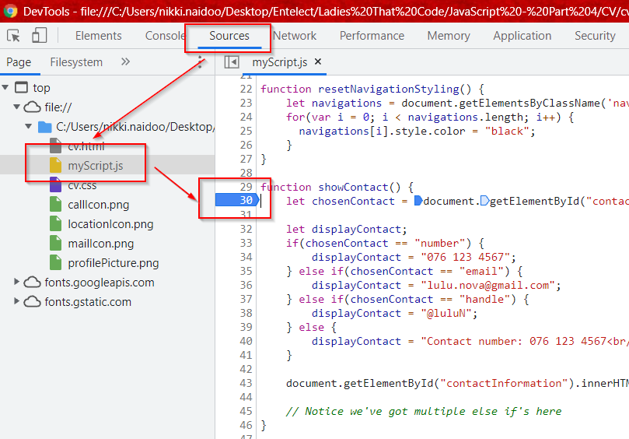
Setting Breakpoints
Click on the Sources Tab of DevTools
Locate your script on the left nav
Click on the line number that you want to add a breakpoint

Slide 51
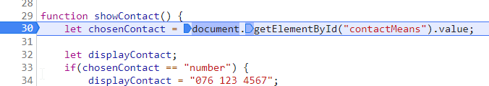
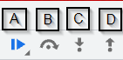
Using Breakpoints
Once the breakpoint is triggered, the line will be highlighted.
You can:
Hover over variables to inspect their values
Press icon A to resume running your script
Press F10 or icon B to step over next function call
Press F11 or icon C to step into next function call
Press SHIFT + F11 or icon D to step out of current function
Find these buttons on the top-right of the screen

Slide 52
The debugger Keyword
The debugger keyword stops the execution of JavaScript and calls the debugging function. This has the same function as setting a breakpoint in the debugger.
With the debugger turned on, this code will stop executing before it executes the third line.
let x = 15 * 5;
debugger;
document.getElementById("demo").innerHTML = x;

Slide 53

Bugs!
Can you guess what the first bug was?
Notes:
Debugging is the process of testing, finding, and reducing bugs (errors) in computer programs. The first known computer bug was a real bug (an insect) stuck in the electronics.

Slide 54
Hacking Time!
Notes:
Demo on how to use DevTools on existing websites

Slide 55
Errors
How to handle them in code

Slide 56
Terminology
The try statement lets you test a block of code for errors.
The catch statement lets you handle the error.
The throw statement lets you create custom errors.
An exception is what developers call an error.

Slide 57
Try, catch, and throw
try
{
<process code here>
}
catch(error)
{
<process logic if there was an error>
}

Slide 58
Try, catch, and throw
try
{
let x = null;
let y = 5 / x;
}
catch(error)
{
console.log(‘There is a problem in the code’);
}

Slide 59
Try, catch, and throw
try
{
let x = null;
if (x == null)
{
throw ‘x is not defined’;
}
let y = 5 / x;
}
catch(error)
{
console.log(error);
}

Slide 60
Errors Demo

Slide 61
Classes

Slide 62

Classes
What are the differences in our pets?

Slide 63
Classes
What are the differences in our pets?
Different animals
Different ages
Different colours
Different names

Slide 64
Classes
What are the differences in our pets?
Different animals
Different ages
Different colours
Different names
We can create a template with animal type, age, colour, and name! This is exactly what a class is!

Slide 65
Classes
class Pet {
constructor(name, age, colour, animal) {
this.name = name;
this.age = age;
this.colour = colour;
this.animal = animal;
}
}

Slide 66
Classes
class Pet {
constructor(name, age, colour, animal) {
this.name = name;
this.age = age;
this.colour = colour;
this.animal = animal;
}
}
let nikkisPet = new Pet(“Chipotle", 3, “black”, “cat”);
let bobsPet = new Pet(“Harry", 10, “brown”, “dog”);

Slide 67
Classes Demo

Slide 68
Reserved Words

Slide 69
Reserved Words
In JavaScript you cannot use certain reserved words as variables, labels, or function names. These words are already assigned to keywords, types, pre-defined functions, etc.
Some examples of reserved words that you’ve already seen are:
let null false if Date void case throw
What other reserved words can you think of?
Notes:
See a full list of reserved words here:
https://www.w3schools.com/js/js_reserved.asp

Slide 70

Reserved Words
If reserved words didn’t exist, we’d see strange things like this:
let let = false;
let false = let;
let new = “26 March 1996”
let Date = new String(new)
What problems do you see here?

Slide 71
Best Practices

Slide 72
Avoid Global Variables
Minimize the use of global variables. This includes all data types, objects, and functions.
Global variables and functions can be overwritten by other scripts.
Use local variables instead, and learn how to use closures.
Notes:
Global variables can be made local (private) with closures. Read more here:
https://www.w3schools.com/js/js_function_closures.asp

Slide 73
Always Declare Local Variables
All variables used in a function should be declared as local variables.
Local variables must be declared with the var keyword or the let keyword, otherwise they will become global variables.
Notes:
Strict mode does not allow undeclared variables.

Slide 74
Declarations on Top
It is a good coding practice to put all declarations at the top of each script or function.
This will:
Give cleaner code
Provide a single place to look for local variables
Make it easier to avoid unwanted (implied) global variables
Reduce the possibility of unwanted re-declarations

Slide 75
Declarations on Top
// Declare at the beginning
let firstName, lastName, price, discount, fullPrice;
// Use later
firstName = "John";
lastName = "Doe";
price = 19.90;
discount = 0.10;
fullPrice = price - discount;

Slide 76
Initialize Variables
It is a good coding practice to initialize variables when you declare them.
This will:
Give cleaner code
Provide a single place to initialize variables
Avoid undefined values
// Declare and initiate at the beginning
let firstName = "";
let price = 0;
const myArray = [];
const myObject = {};
Notes:
Initializing variables provides an idea of the intended use (and intended data type).

Slide 77
Declare Objects with const
Declaring objects with const will prevent any accidental change of type:
let car = {type:“VW", model:“Vivo", color:“blue"};
car = “VW"; // Changes object to string
const car = {type:"VW", model:"Vivo", color:"blue"};
car = “VW"; // Not possible
Notes:
A variable can be changed at any time to a different type. Be sure to assign the right type to your variables!

Slide 78
Declare Arrays with const
Declaring arrays with const will prevent any accidental change of type:
let cars = [“Fiat", "Volvo", "BMW"];
cars = 3; // Changes array to number
const cars = [“Fiat", "Volvo", "BMW"];
cars = 3; // Not possible

Slide 79
Don't Use new Object()
Declaring these types as objects, slows down execution speed, and produces nasty side effects.
Use "" instead of new String()
Use 0 instead of new Number()
Use false instead of new Boolean()
Use {} instead of new Object()
Use [] instead of new Array()
Use /()/ instead of new RegExp()
Use function (){} instead of new Function()

Slide 80
Don't Use new Object()
let x1 = ""; // new primitive string
let x2 = 0; // new primitive number
let x3 = false; // new primitive boolean
const x4 = {}; // new object
const x5 = []; // new array object
const x6 = /()/; // new regexp object
const x7 = function(){}; // new function object

Slide 81
Don't Use new Object()
//Possible side effects
let x = "John";
let y = new String("John");
(x === y) // is false because x is a string and y is an object.
let x = new String("John");
let y = new String("John");
(x == y) // is false because you cannot compare objects.
Notes:
Objects can be compared with:
JSON.stringify(x) === JSON.stringify(y);
Lodash: _.isEqual(x, y);

Slide 82
Use === Comparison
The == comparison operator always converts (to matching types) before comparison.
The === operator forces comparison of values and type:
0 == ""; // true
1 == "1"; // true
1 == true; // true
0 === ""; // false
1 === "1"; // false
1 === true; // false
Notes:
With ==, only value needs to be the same
With ===, both value and type needs to be the same

Slide 83
Use Parameter Defaults
If a function is called with a missing argument, the value of the missing argument is set to undefined.
Undefined values can break your code and lead to unexpected exceptions. It is a good habit to assign default values to arguments.
function myFunction(x, y) {
if (y === undefined) {
y = 0;
}
x = y / 2;
}

Slide 84
Use Parameter Defaults
If a function is called with a missing argument, the value of the missing argument is set to undefined.
Undefined values can break your code. It is a good habit to assign default values to arguments.
// ECMAScript 2015 allows default parameters in the function definition:
function myFunction(a=1, b=1) {
let c = a * b;
}

Slide 85
End Your Switches with Defaults
switch (genderId) {
case 0:
gender = “Male";
break;
case 1:
gender = “Female";
break;
case 2:
gender = “Other";
break;
default:
gender = "Unspecified";
}
Notes:
Please do it even if you think there is no need. It is best practice ☺

Slide 86

Avoid Using eval()
The eval() function is used to run text as code. In almost all cases, it should not be necessary to use it.
Because it allows arbitrary code to be run, it also represents a security problem.
If you were a malicious hacker, what code would you enter?

Slide 87
Thanks!
ANY QUESTIONS?

